Slide 1








Alishba-Malik
Alishba-Malik/README.md
ALISHBA HERE
CYS Student at AU pk
... I am currently working on cyber lab project
The topic of my project is "CLICKJACKING"
Mai-hu-aur-mere-sath-bhi-mai-hi-hu
Ask me about Clickjacking or nothing
Fun fact: No room for lame questions
Jahaz Alishba
Alishba-Malik​

Slide 2
Overview:
Clickjacking
How it arises
Exploitation
Patching

Slide 3
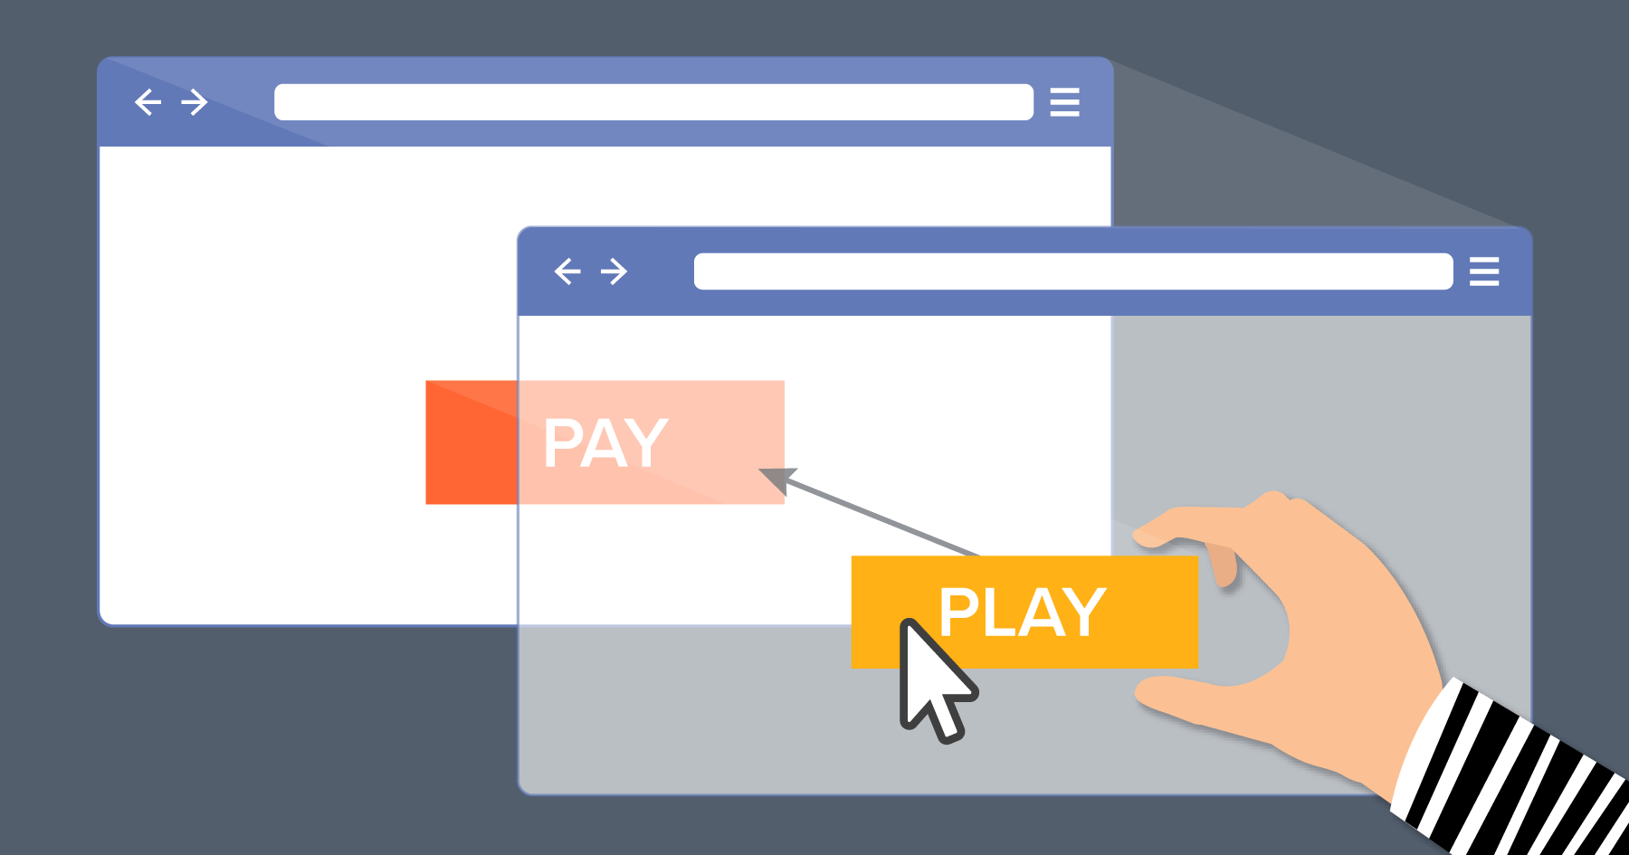
CLICKJACKING:
Primarily web based attack
UI redressing attack
Deceptive attack
manipulate user interfaces
Used to trick users into interacting with malicious elements unknowingly.

Slide 4
How it arises:
Deceptive Overlay Techniques:
Invisible Elements:
Attackers overlay invisible or transparent elements, making them visually undetectable.
Hidden Iframes:
Malicious iframes are positioned over legitimate content to deceive users.
Likejacking
Button jacking
Cursorjacking

Slide 5
Misleading User Perception:
Altering User Interaction: Users are led to believe they're interacting with visible content when, in reality, their actions affect hidden elements.
Manipulating UI Elements: Deceptive placement of elements tricks users into performing unintended actions.
UI redressing

Slide 6
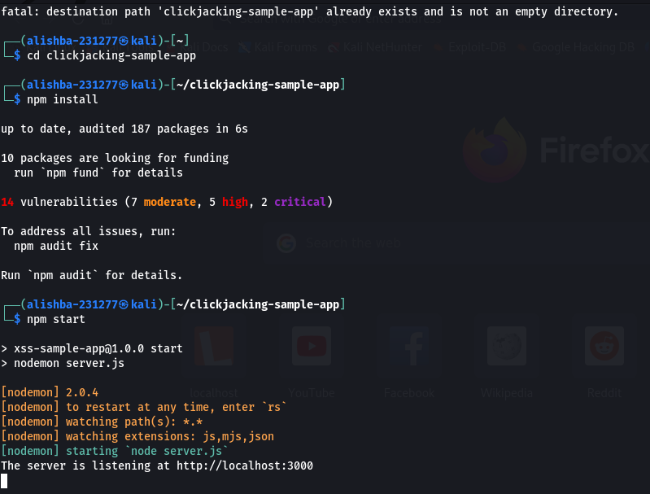
Exploitation:
Setting up the environment:
git clone https://github.com/auth0-blog/clickjacking-sample-app.git
npm install
npm start

Slide 7
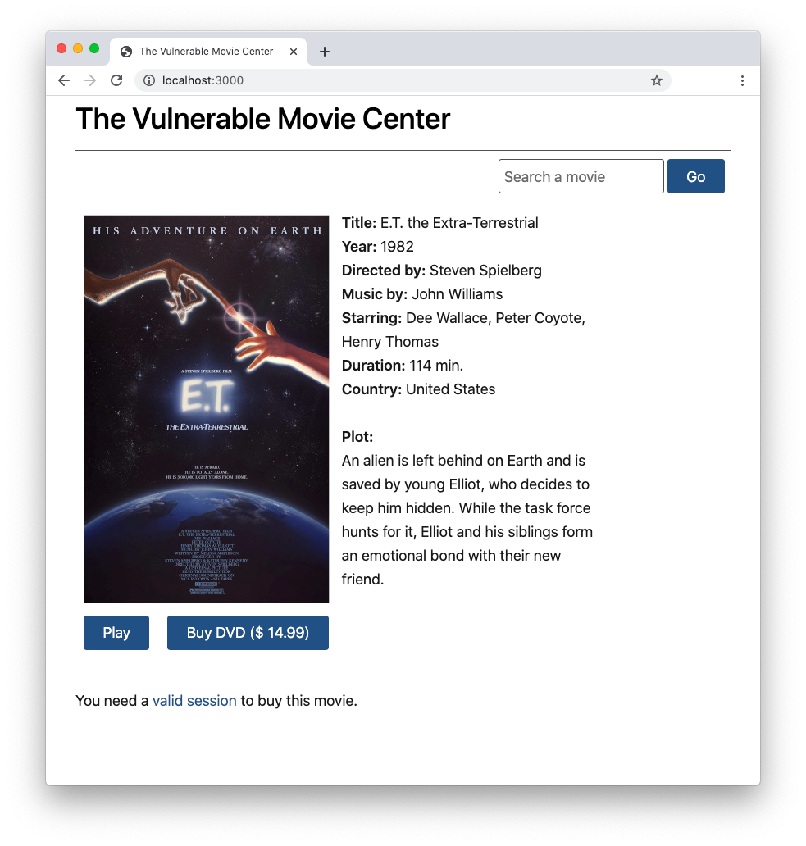
open your browser and navigate to the http://localhost:3000 address.

Slide 8
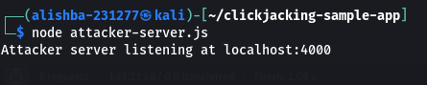

Launch the clickjacking attack:
node attacker-server.js
open a new tab or a new instance of your browser and navigate to http://localhost:4000.

Slide 9
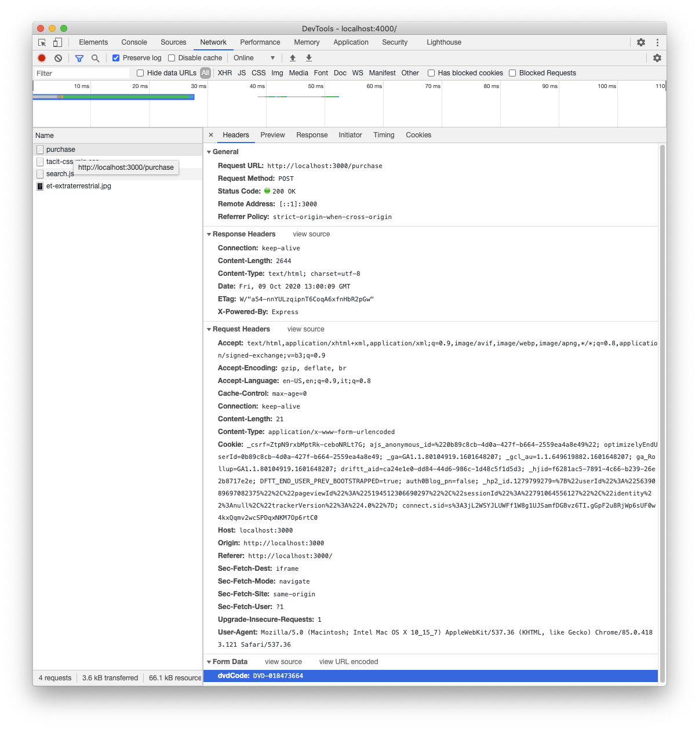
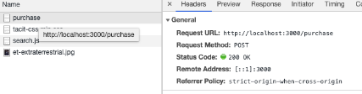
opening the developer tool of your browser and analyzing the network traffic while clicking the button
HTTP POST request to the http://localhost:3000/purchase

Slide 10
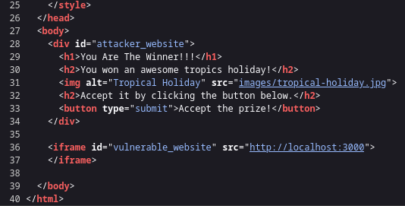
. Move to the views folder and open the index.ejs
Anatomy of the attack
Move to the views folder and open the index.ejs
The visible part of the page is defined by the div with the attacker_website identifier.
The iframe with the vulnerable_website id points to the movie website, but actually, you don't see it on the attacker's page.

Slide 11
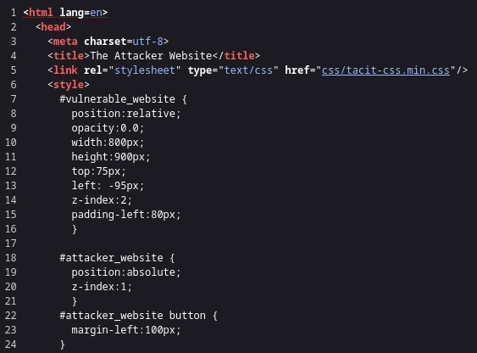
it is positioned so that it overlaps the attacker_website div.
The trick that connects the two websites is performed by the CSS rules defining the position and visibility of those elements
the vulnerable_website iframe has assigned the 0.0 value for its opacity, which makes it transparent.
it is positioned so that it overlaps the attacker_website div.

Slide 12

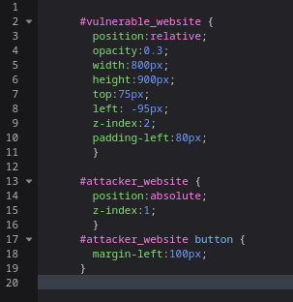
the iframe overlaps the div by adjusting the opacity value of the iframe to 0.3

Slide 13
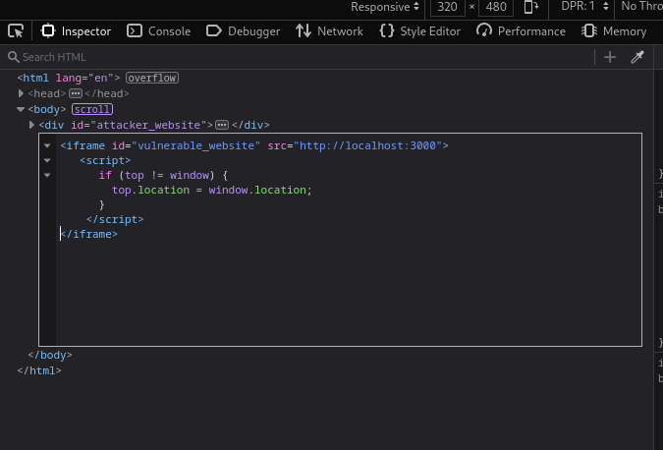
Patching:
Client-side defenses:
frame-busting
If the page of the vulnerable website is not within the browser's topmost window, it is reloaded in the top window.
replaces the attacker's page with the hidden page
git clone -b client-side-defenses https://github.com/auth0-blog/clickjacking-sample-app.git

Slide 14
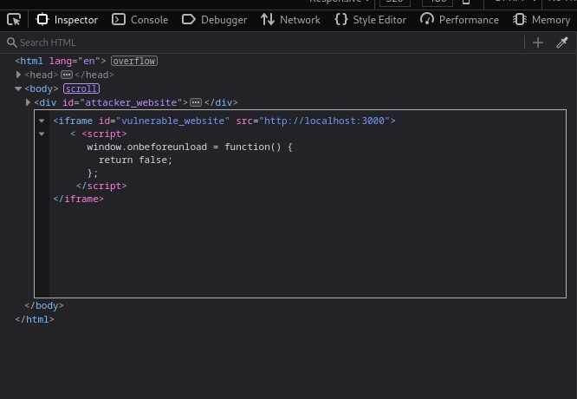
the onbeforeunload event, the attacker attempts to disable the current page dismissal.
This approach could not work in some browsers since it may require user confirmation

Slide 15
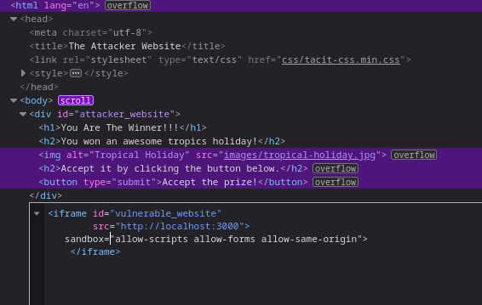
iframe's sandbox attribute
execute scripts (allow-scripts)
submit forms (allow-forms)
same origin (allow-same-origin).
No other permission is specified, so the iframe content cannot replace the top-level content, as the allow-top-navigation value would have allowed.

Slide 16
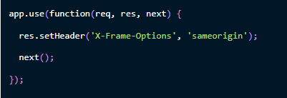
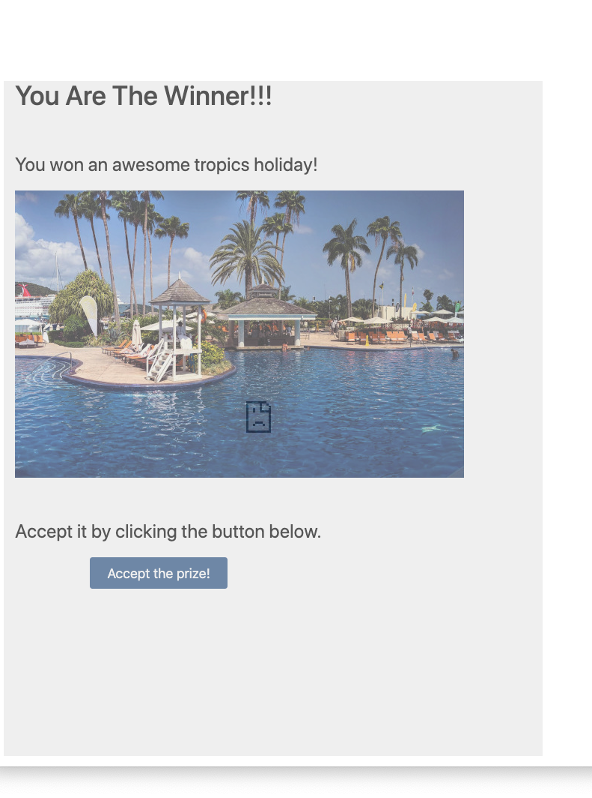
Using the X-Frame-Options header:
git clone -b x-frame-options https://github.com/auth0-blog/clickjacking-sample-app.git
Edit file server.js
Add the following code in server.js
The value associated with this response header is sameorigin

Slide 17
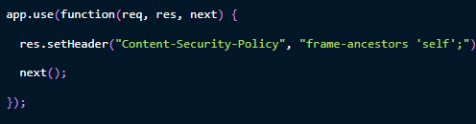
frame-ancestors 'none'; : This prevents any attempt to include the page within a frame.
Using CSP:
Again using server.js
Content-Security-Policy header with the frame-ancestors 'self';
X-Frame-Options header with the sameorigin value.
frame-ancestors 'none'
frame-ancestors https://www.authorized-website.com

Slide 18
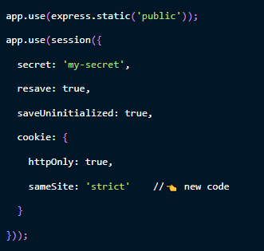
Using cookie's sameSite origin
git clone -b same-site-cookie https://github.com/auth0-blog/clickjacking-sample-app.git

Slide 19

QUERIES
alishbamalik1080@gmail.com
https://www.linkedin.com/in/alishba-malik-
https://github.com/Alishba-Malik/Alishba-Malik/issues

